Slide 1
FOSSEE Summer Internship on Social Network Analysis using R Studio
Presented by:
Arnab Karmakar(19BAI1090)
Final Year Undergraduate Student,
School of Computer Science and Engineering
CSE1902- Industrial Internship Review

Slide 2
Table of Contents
Introduction
Methodology
Data Collection
Data Analysis
Visualizing Social Networks (Tcl/Tk Network Graph)
Result and Discussion
Conclusion
Future Work
References

Slide 3
Address and Contact Details
Dr. Ganesan R, Dean of the School of Computer Science & Engineering, VIT Chennai
Vellore Institute of Technology,
Vandalur – Kelambakkam Road Chennai,
Tamil Nadu – 600 127
Email: dydircc.ads@vit.ac.in
Under the Guidance of
Prof. Mohana N, Department of Mathematics VIT, Chennai

Slide 4
Introduction
Every kind of social aggregation can be represented in terms of units composing this aggregation and relations between these units. This kind of representation of a social structure is called “Social Network”. In a social network, every unit, usually called “social actor” (a person, a group, an organization, a nation, a blog and so on), is represented as a node. A relation is represented as a linkage or a flow between these units. The set of possible relations is potentially infinite; the term relation can have many different meanings: acquaintance, kinship, evaluation of another person, the need of a commercial exchange, physical connections, the presence in a web-page of a link to another page and so on. Therefore, the objects under observation are not individuals and their attributes, but the relationships between individuals and their structure. The advantage of such a representation is that it permits the analysis of social processes as a product of the relationships among social entities. In Social Network Analysis we can study two different kinds of variables: structural and composition. Variables of the first type are the most important in this field because they represent the different kinds of ties between social actors (friendship, trust and so on).

Slide 5
Methodology
Data Exploration
Loading Social Network Data:- Loading An Edgelist
directed vs. undirected
SNA data also can also be represented as a sociomatrix
# Social Network Analysis
library(igraph)
g <- graph(c(1,2,2,3,3,4,4,1),
directed = F,
n=7)
plot(g,
vertex.color = "green",
vertex.size = 40,
edge.color = 'red')
g[]

Slide 6
g1 <- graph(c("Amy", "Ram", "Ram", "Li", "Li", "Amy",
"Amy", "Li", "Kate", "Li"),
directed=T)
plot(g1,
vertex.color = "green",
vertex.size = 40,
edge.color = 'red')
g1
# Network measures
degree(g1, mode='all')
degree(g1, mode='in')
degree(g1, mode='out')
diameter(g1, directed=F, weights = NA)
edge_density(g1, loops = F)
ecount(g1)/(vcount(g1)*(vcount(g1)-1))
reciprocity(g1)
closeness(g1, mode='all', weights = NA)
betweenness(g1, directed=T, weights=NA)
edge_betweenness(g1)

Slide 7
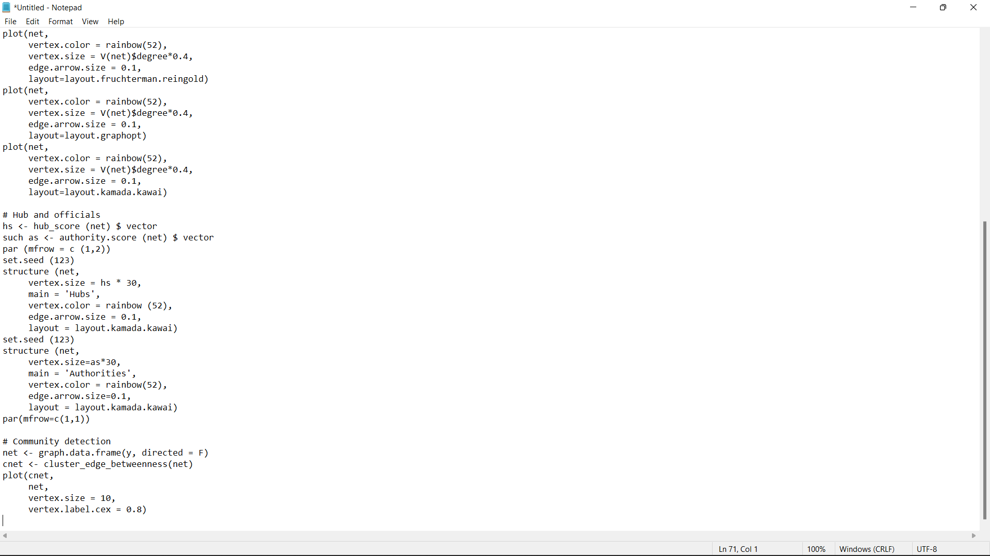
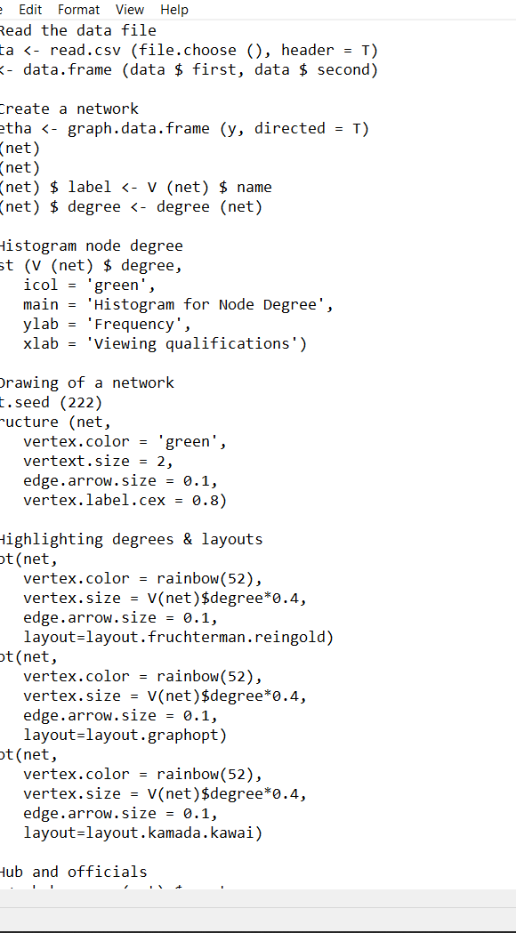
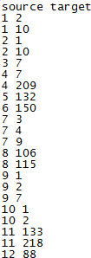

Slide 8

Data Collection

Slide 9
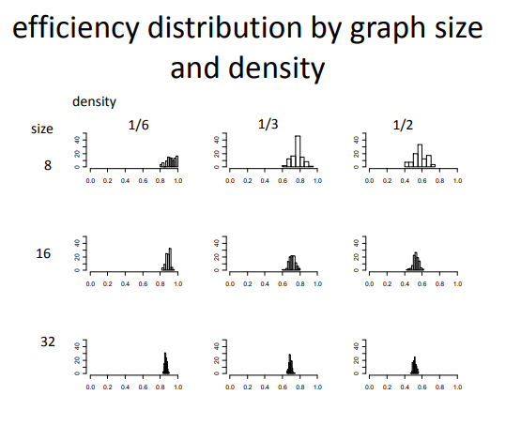
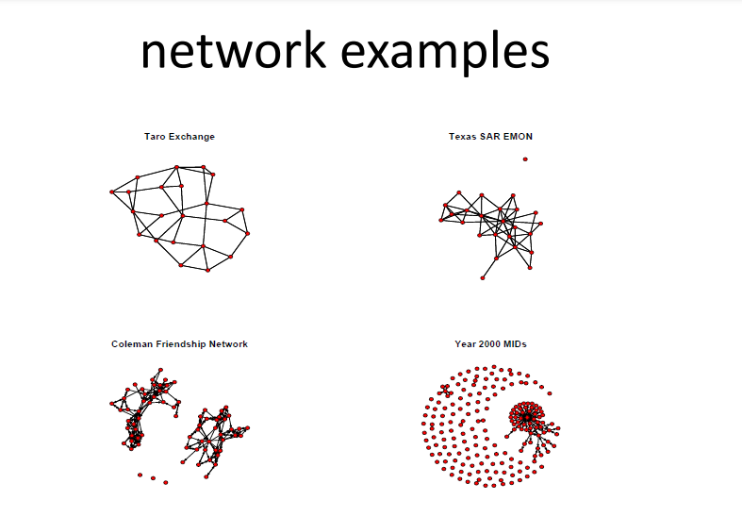
Data Analysis
Differ by Graph index
• Degree distribution
• average node-to-node distance – average shortest path length
• clustering coefficient – Global, local

Slide 10


Slide 11
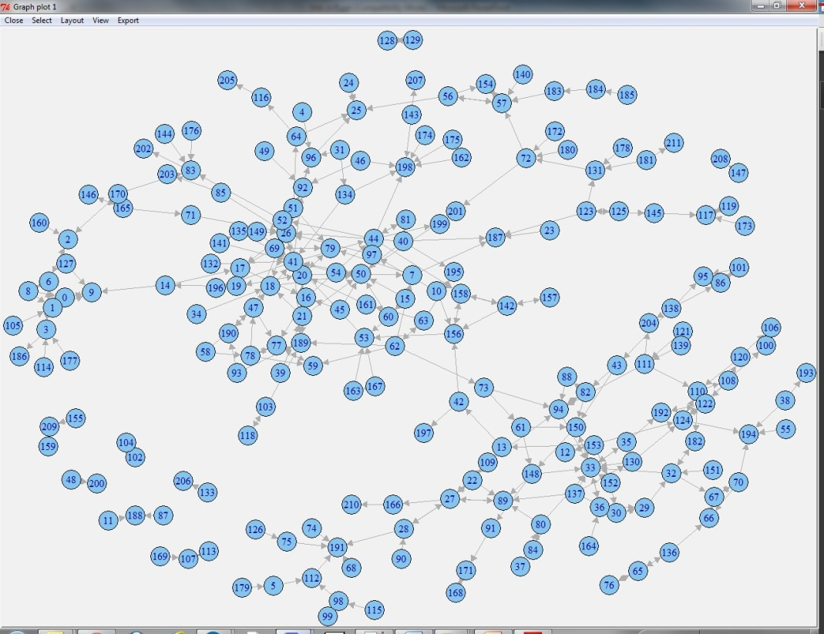
Visualizing Social Networks (Tcl/Tk Network Graph)
tkplot(igraph,
layout=layout.fruchterman.reingold)
Finding Key Actors
Centrality Measures Medium or prominence is a well-known metric for determining a person's position within the overall structure of a social network. It can be computed using a variety of measures. Diploma, betweenness, proximity, and eigenvector centrality are the most commonly utilised. The first three were proposed by Freeman (1978) and are best suited for low-bandwidth networks. Brin and Page (2012) recently came up with extensions for weight loss networks. Analog (1987) presented the fourth measure, eigenvector centrality, which is based entirely on a spectral graph approach. It gained a lot of traction once it was utilised as the foundation for the well-known Google PageRank algorithm, which we'll go over in the next part. Whereas other quantitative measures for individual degree are proposed in the literature, we will focus on defining median values in this section. These processes determine the individual's relative cost within the network, indicating how relationships are targeted on some persons and, as a result, providing information on the societal power.
Greater centre levels were associated with much more prominent characters inside the group, as their central location grants them benefits such as easier and faster access to various personalities.

Slide 12
Plot Eigenvector Centrality on Betweenness
This measure assesses how a protagonist is linked to certain other well-linked individuals and is predicated on the distribution of correlated values in each and every region. A first eigenvalues of the data structure is given this position. The basic premise of embedded is that a person's ability and status are continuously determined by the power and position of his switching. Figures who really are immediately linked to a certain personality, described to as the psyche, are called to as Changes over time. Alters is a term widely used in the examination of a narcissistic shared community. In other words, we can state that a single node's lengths are proportional to the combined of its nearby items.
• Alternatively is to adjust / reverse eigenvector central ness during fossil testing.
- A character with a high concentration and low eigenvector centrality may be an important gate keeper for the middle character.
- A low-key character and a high middle eigenvector may have a unique access to mid-level players.

Slide 13
Results
Graph Representations
Charts are forms of metadata architectures that have been addressed in the literature: category organization and divisional structure. These formats are appropriate for saving diagrams on a system so that technical solutions may examine these. Action listings & neighbouring listings are examples of collection architectures.
Tiny diagrams have less hard drive capacity, making them excellent for archiving.
On the other hand, matrix structures such as the Incidence Matrix, the Adjacence Matrix or the Social Matrix, the Laplacean matrices (which contain both adjacent and degree information) and the distant matrices (adjacent matrices with the same length as the matrix entries are shorter than the pairs of headers). Ways) are suitable for referring to complete matrices. A variety of graphs can be used to model different types of social networks.

Slide 14
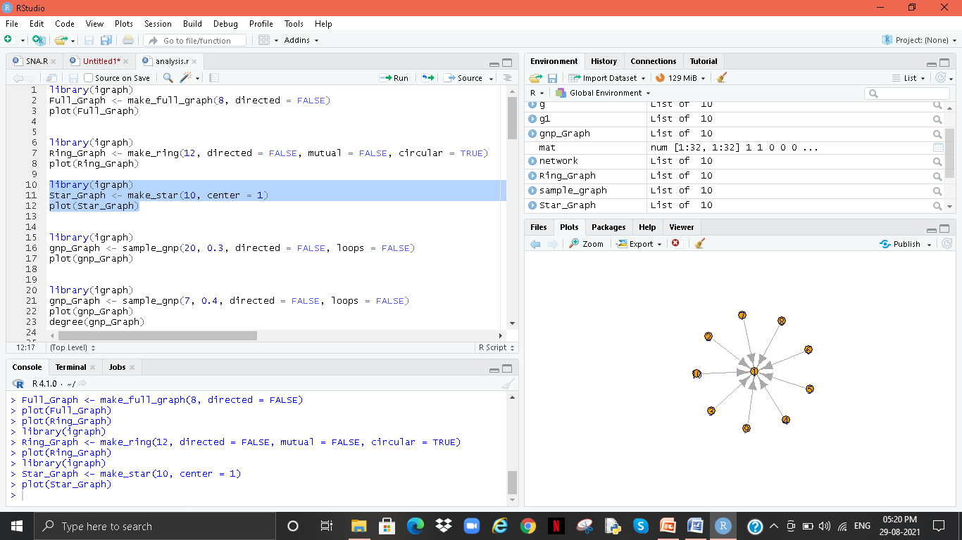
Star Graph

Slide 15
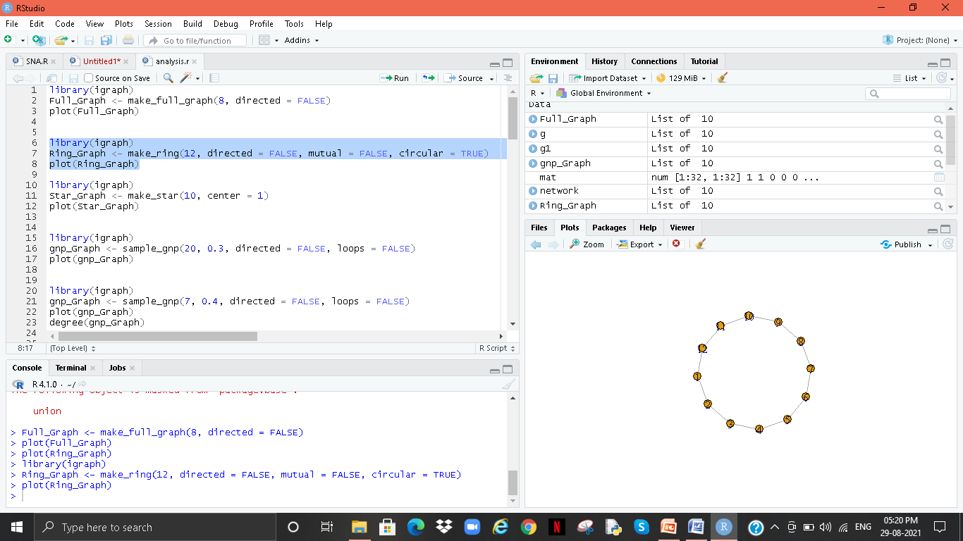
Ring Graph

Slide 16
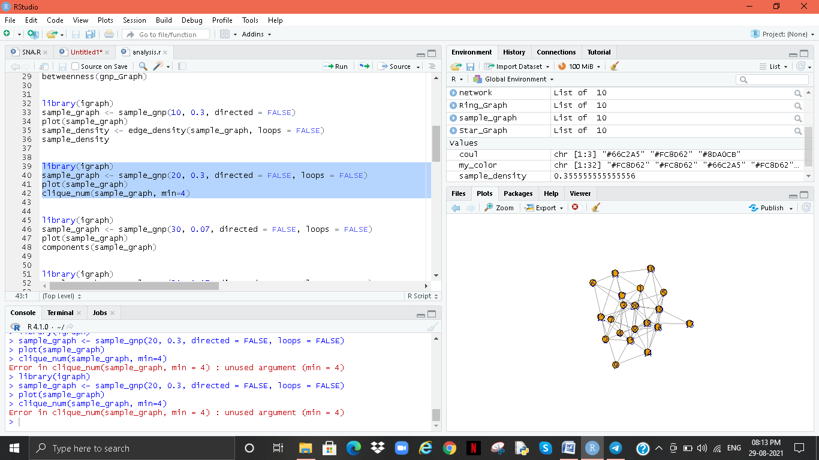
Clique Graph

Slide 17
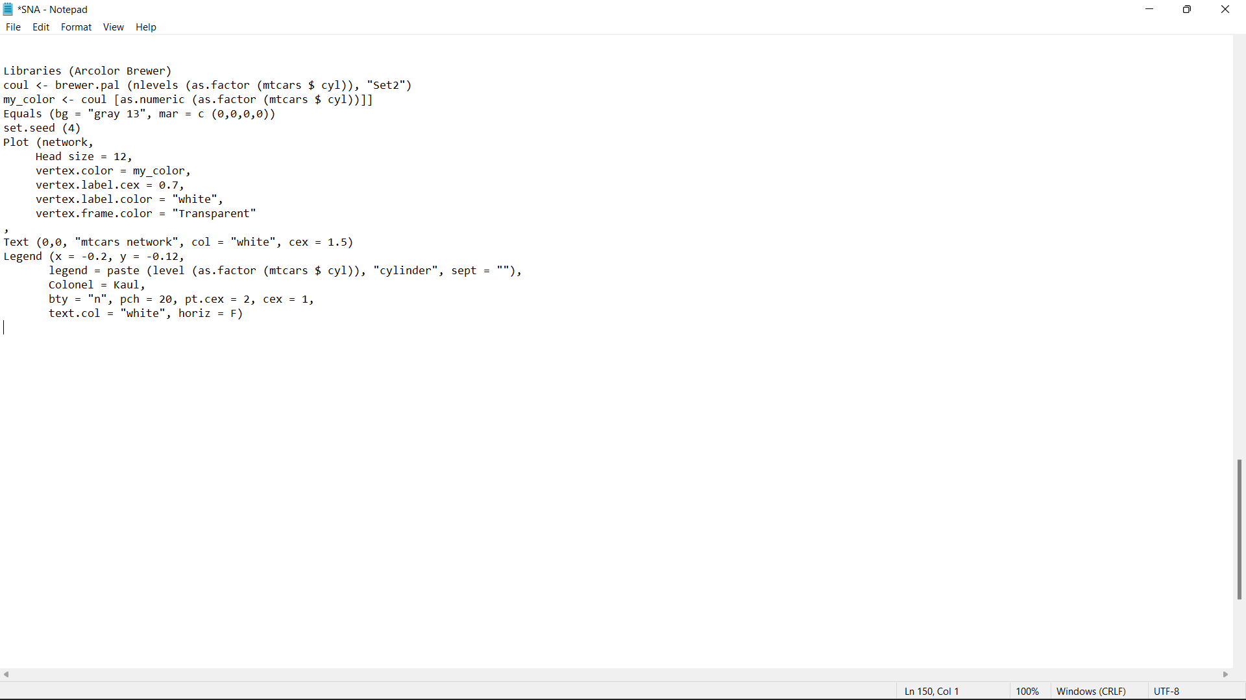
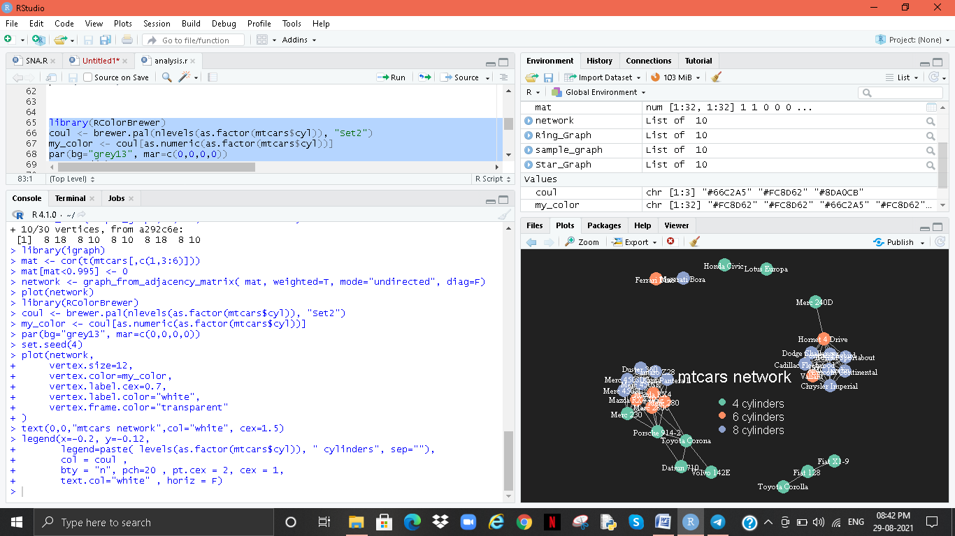
Final - car to Bluetooth device connections

Slide 18
Conclusion and Future Work
SNA is seldom chastised for concentrating upon methodological issues rather than complicated & profound experimental identifying situations on clear and strong complex algorithms such as computational geometry and relatively non mathematics, as I just stated. This strategy. There are still numerous concerns to be handled in the paradigm, even though there are many empirical issues relating to the potential of researching social elements of an internet.
I've given a quick summary of link prediction methodology, aims, and applications in this presentation. Numerous SNA activities and related duties are carried out while bearing in mind various network types. Hierarchical clustering has become increasingly common today, thanks to the high quality of network troubleshooting and knowledge obtained from data supplied by a multitude of scenarios. As the volume of commitment to providing grows, so does the sophistication.

Slide 19
One of the primary problems right now is advancement with in analysis, management, and exploitation of significantly large connections. It is getting increasingly intensive and complicated as Internet 2.0, Rfid, and other technologies proliferate.
Informatics, Earth Science, Cognitive Science, Mobility Patterns, Recommendations, etc. Fraud detection, along with social media, gene expression, protein interactions, marketing, brainstorming prediction, etc. The recent growing demand for these applications on complex realities also requires progress in the world
Various network topologies such as multi-layered, heterogeneous and development networks. Therefore, this article paves the way for a basic understanding of the more complex issues associated with network analysis.

Slide 20
References
Abraham, A., Hassanien, A.-E., Sná, V. et al. (2009) Computational social network analysis: Trends, tools and research advances.
London: Springer Science & Business Media.
Adamic, L. A. and Adar, E. (2003) Friends and neighbors on the web. Social networks,25, 211–230.
Aggarwal, C. C. (2009) Models for incomplete and probabilistic information. In Managing and Mining Uncertain Data, 1–34.
A. El-Sheikh and S.D. Pryke, Construct Manag Econ, 28, 1205 (2010).
D. Hinds and R. M. Lee, Hawaii International Conference on System Sciences, Proceedings of the 41st Annual, IEEE, pp. 323-323 (2008).
Geek for Geeks.
H. Kerzner, Advanced project management: Best practices on implementation (2004).
H.J. Thamhaim and D. L. Wilemon, SLOAN MANAGE REV., 16,31 (1975).
H.R. Kerzner, Project management: a systems approach to planning, scheduling, and controlling (2013).
https://www.itm-conferences.org/articles/itmconf/pdf/2016/01/itmconf_ics2016_03011.pdf

Slide 21
J.R. Turner and R. Muller, Int J Project Manage, 21, 1 (2003).
M.B. Pinto and J.K. Pinto, JPIM, 7, 200 (1990).
P.S. Chinowsky, J. Diekmann and J. O'Brien, JCEM, 136, 452 (2009).
P. Dietrich, IJPM, 37, 49 (2006).
P. He, B. Li and Y. Huang, Second International Conference on CGC, pp. 418-423 (2012).
P. Chinowsky, J. Diekmann and V. Gaiotti, JCEM, 134, 804 (2008).
P. Chinowsky and J.E. Taylor, EPOJ, 2, 15 (2012).
R. Alsamadani, M. Hallowell and A. N. JavemickWill, CEM, 31, 568 (2013).
S.D. Pryke, Construct Manag Econ, 23,927 (2005).
T. Cooke-Davies, Int J Proj Manage, 20, 185 (2002).
T. Mueller-Prothmann and I. Finke, J. UCS, 10, 691 (2004).
W.A. Reed, Doctoral dissertation (2006).

Slide 22
Thank You

